Slide 1
Book Bans in the U.S.
Data Analytics Bootcamp Project 3
Columbia School of Engineering
Jennifer Kim, Kat McEldowney & Scott Zuckerbrow
March 4, 2024

Slide 2
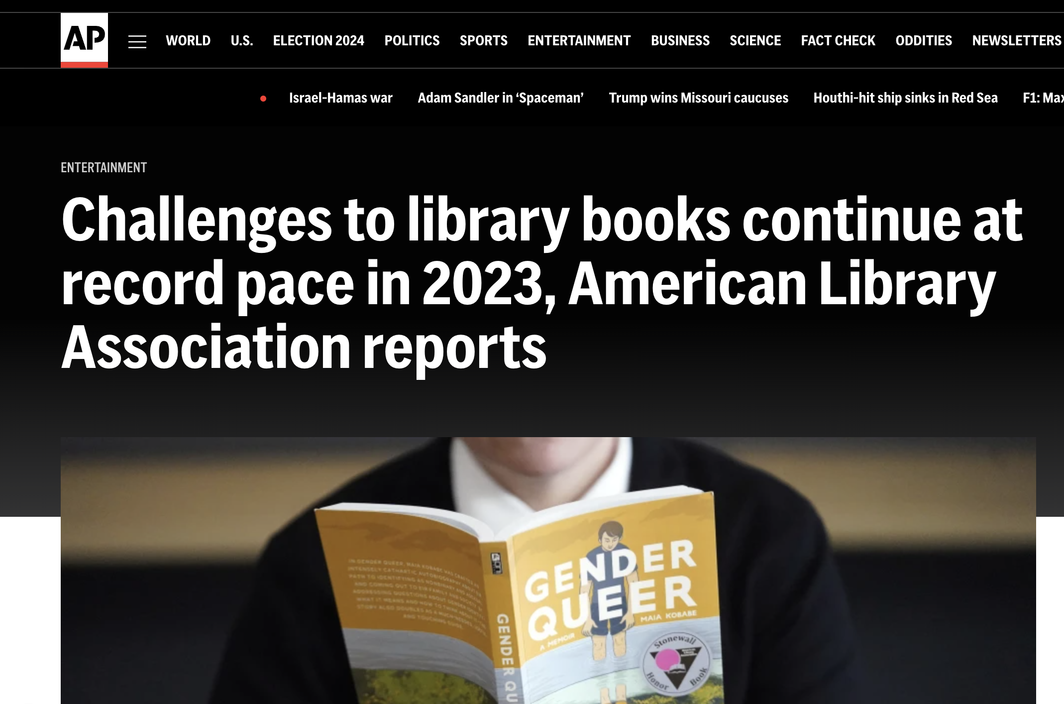

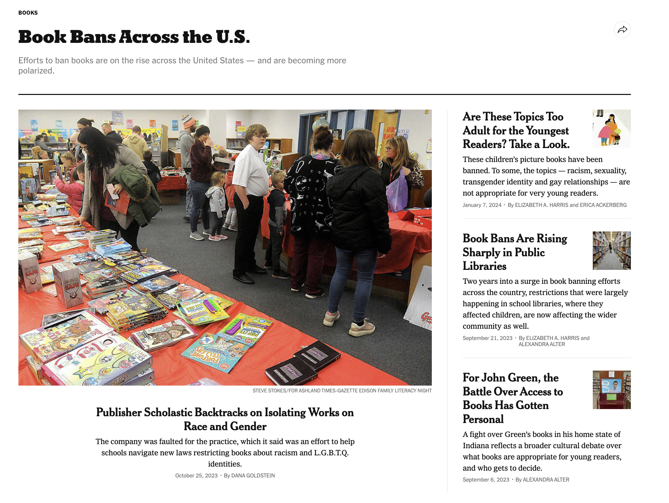
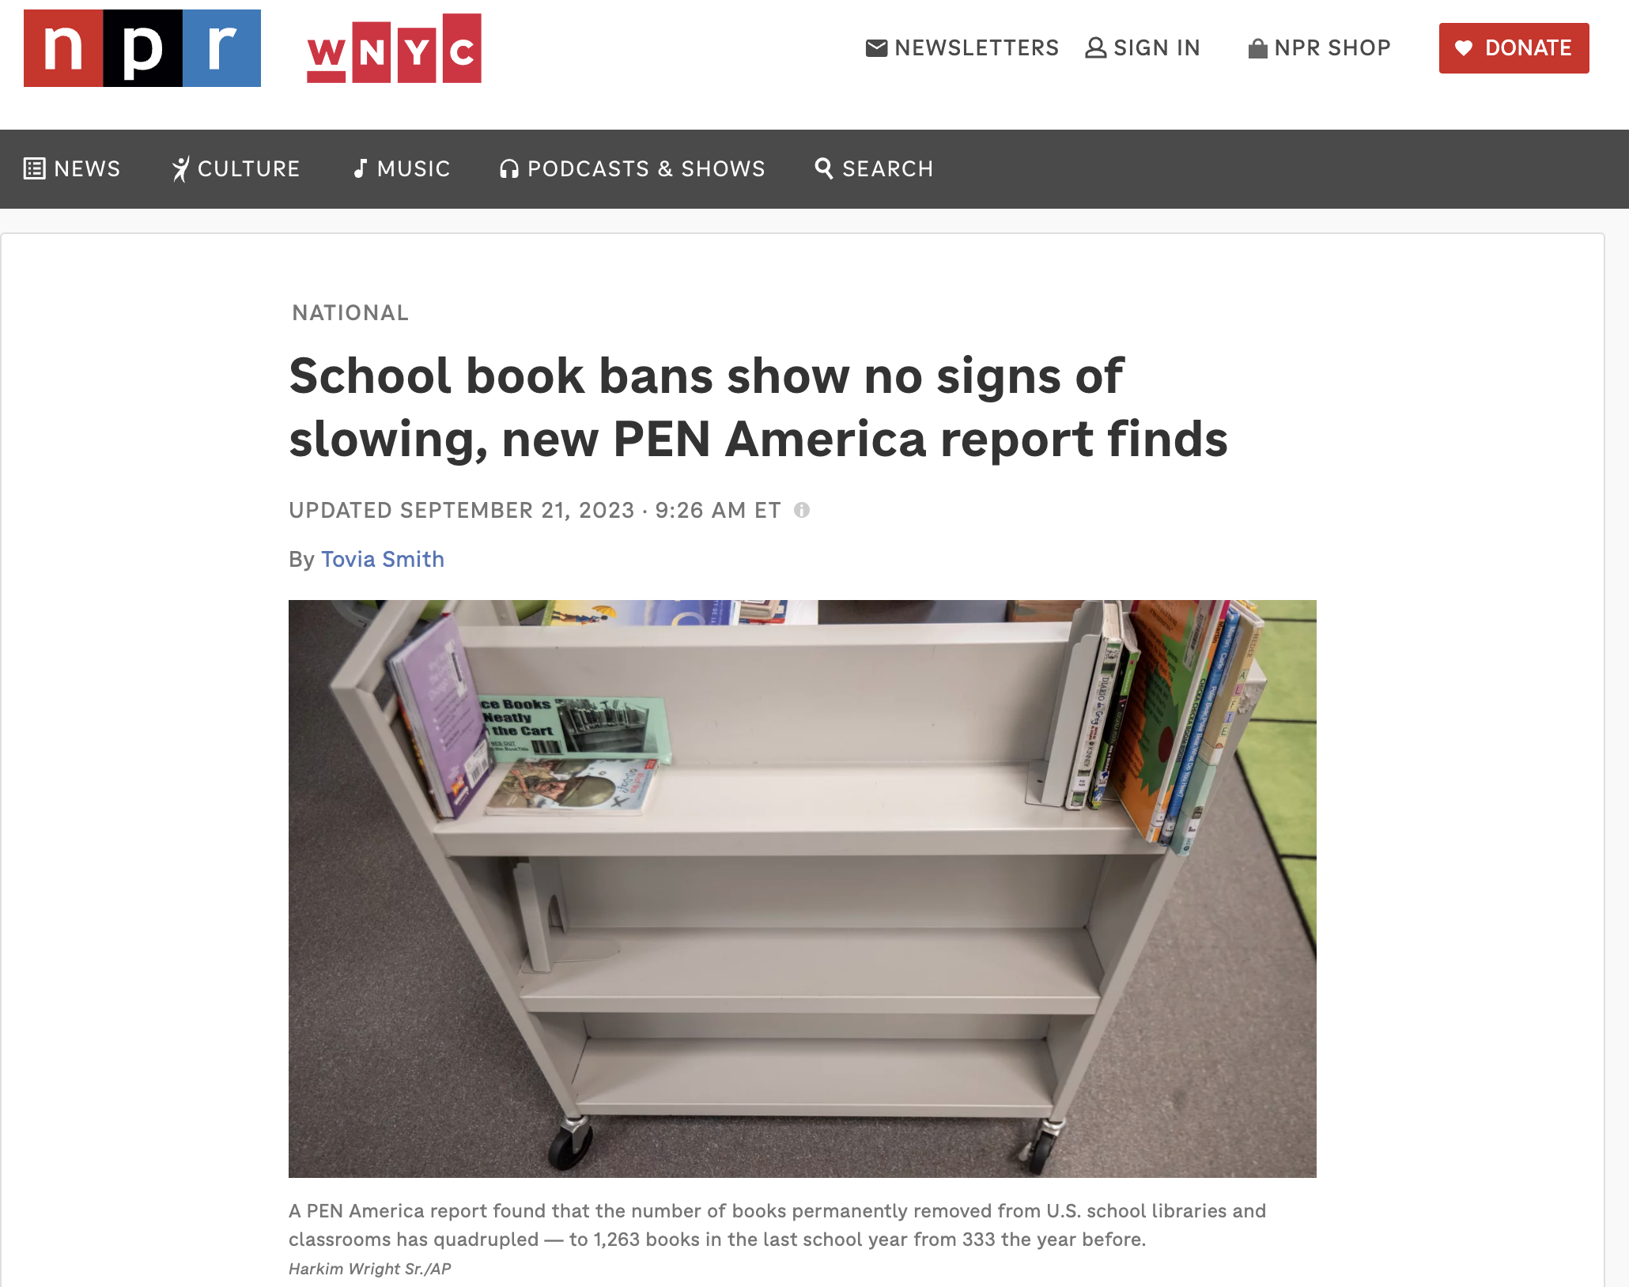
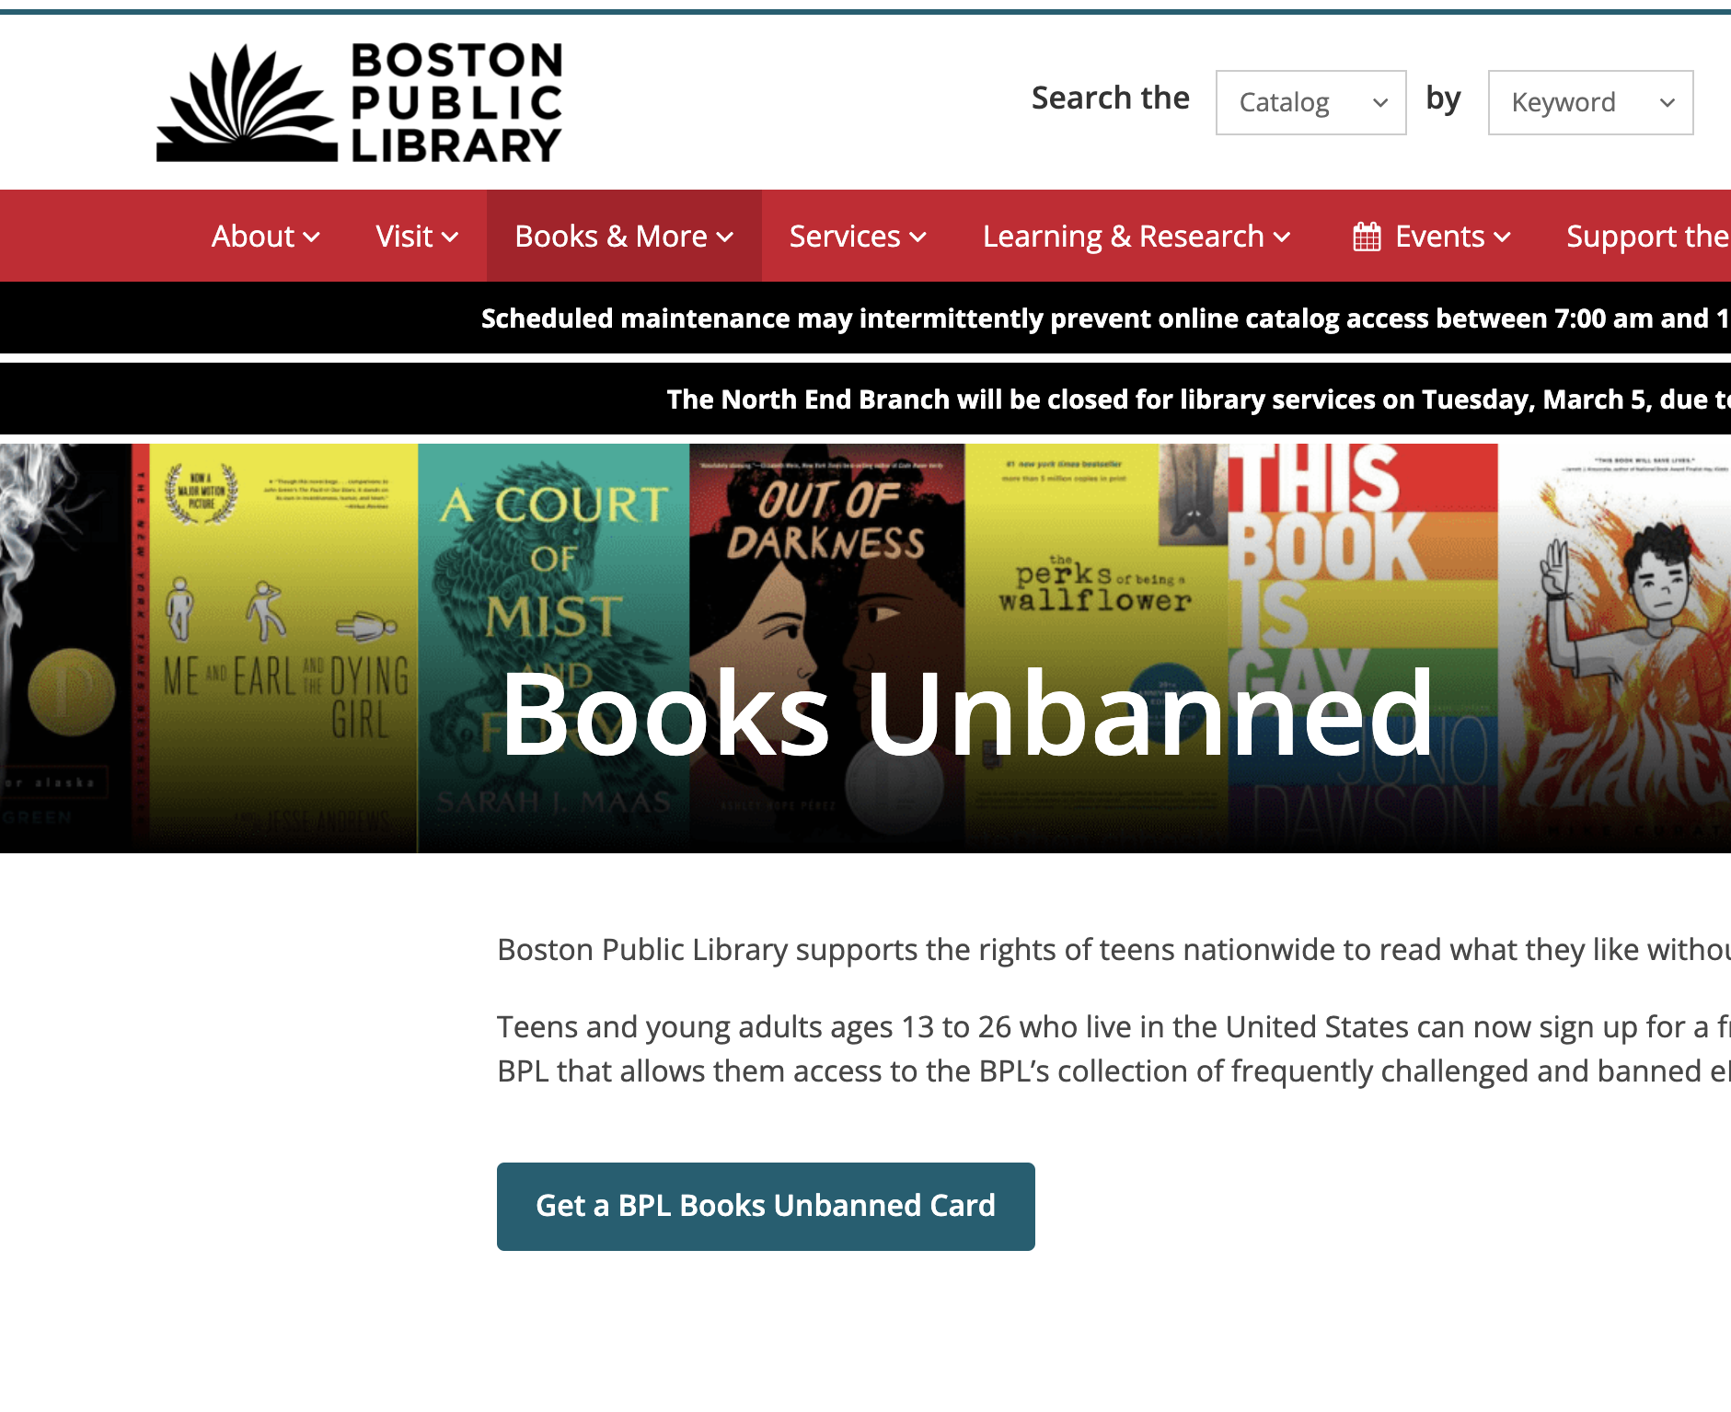


Slide 3
Book Ban Definition
Challenge: an attempt to remove or restrict access to materials or services based on the objections of a person
Ban: a book is entirely removed from a collection in response to a formal or informal challenge

Slide 4
Data Sources
American Library Association
PEN America (7/1/2021-12/31/2022)
Open Library

Slide 5
Methods
CSV’s to DataFrames in Jupyter Notebook
API calls to JSON
Dashboard programmed in HTML, JavaScript and CSS
Data Engineering
Data Visualization

Slide 6

13 Most Banned Titles

Slide 7
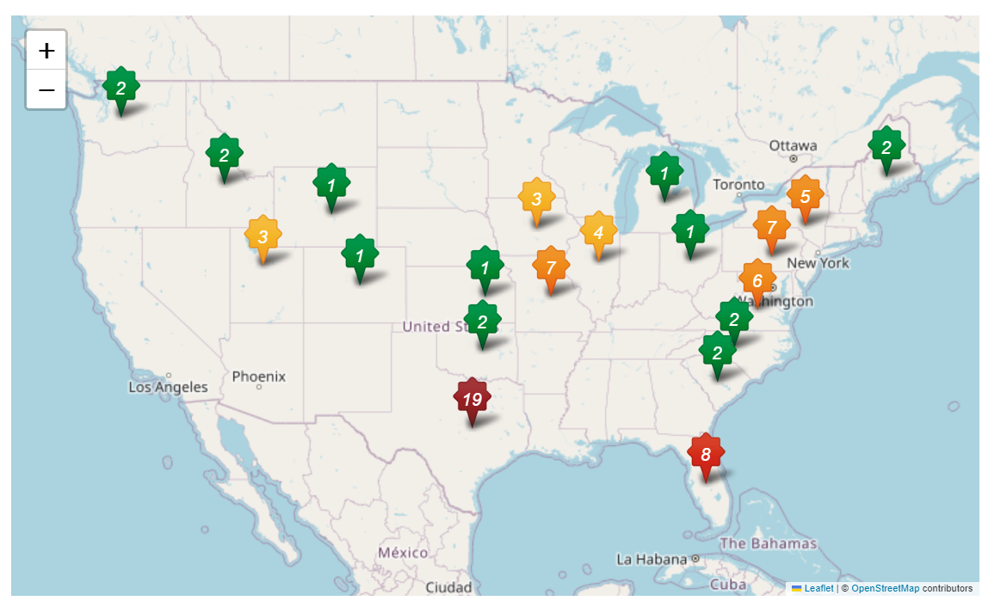
Total Bans per Title and State

